Slide 1


The Knapsack Problem
ALGORITHMS · DYNAMIC PROGRAMMING
From brute force to dynamic programming, step by step
Nehal Saad · 25070521071
Notes:
Welcome everyone. Today I will explain the knapsack problem from scratch: what it is, why the obvious solutions fail, and how dynamic programming solves it. We will follow one small example all the way through, with a flowchart, a table and the final code.

Slide 2
How this talk flows
ROADMAP
1
2
3
4
5
6
The problem
Brute force
Greedy
Dynamic programming
Complexity
Uses
Pack the most value into a limited bag
Try every possible subset
Pick by value per kg: fast, but not always right
How fast, and how much memory
Real problems it models
Build the answer from smaller subproblems
Each step fixes a weakness of the one before it.
Notes:
This is the path we will take. We start with the problem, try the obvious brute force idea, then a greedy idea, and see why each one falls short. Dynamic programming is the main part of the talk. We finish with complexity and real applications.

Slide 3
The hiker’s dilemma
01 · THE PROBLEM
THE BAG
A
Torch
B
Tent
7 kg
1 kg · value 1
3 kg · value 4
C
Stove
D
Camera
is all it can carry
4 kg · value 5
5 kg · value 7
Which items should go in the bag to get the most total value without passing 7 kg?
Value is a usefulness score. Each item exists once, and it goes in whole or stays out.
Notes:
Imagine a hiker with a bag that holds 7 kilograms. There are four items, each with a weight and a usefulness score. Everything together weighs 13 kilograms, so we cannot take it all. This exact example will follow us through the whole talk.

Slide 4
Formal definition
01 · THE PROBLEM
Symbol | Meaning
n | number of items
w[i] | weight of item i
v[i] | value of item i
W | capacity of the bag
x[i] | 1 if item i is taken, else 0
maximize
Σ v[i] · x[i]
subject to
Σ w[i] · x[i] ≤ W
x[i] ∈ {0, 1}
“0/1” means each item is taken whole (x[i] = 1) or left behind (x[i] = 0).
Notes:
Here is the same idea in symbols. We have n items, each with a weight and a value, and a bag with capacity W. For every item we choose x equal to 1 if we take it and 0 if we leave it. We want the largest total value, while the total weight stays within W.

Slide 5
Three kinds of knapsack
01 · THE PROBLEM
Today’s focus
Greedy is optimal
Repeats allowed
0/1 knapsack
Fractional knapsack
Unbounded knapsack
Each item is taken whole or left out. This is the classic packing and selection problem.
Items can be split, like sand or grain, so part of an item can go in the bag.
Every item is available in unlimited copies, so the same item can be packed again and again.
Solved by greedy: best value per kg first
Solved by dynamic programming (1-D)
Solved by dynamic programming
Notes:
There are three common versions. In fractional knapsack you may cut items, and greedy works perfectly. In unbounded knapsack you may repeat items. Today we focus on 0/1 knapsack, where each item is taken whole or not at all, because that is the version that needs dynamic programming.

Slide 6
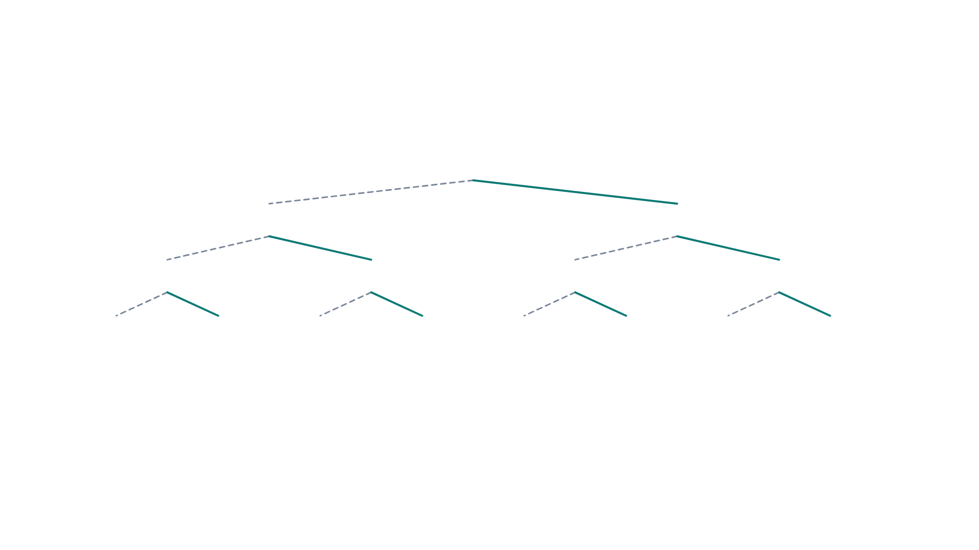
Brute force: the decision tree
02 · BRUTE FORCE
Solid line: take the item · Dashed line: skip the item
Start
skip A
take A
skip B
take B
skip B
take B
skip C
take C
skip C
take C
skip C
take C
skip C
take C
0 kg
4 kg
3 kg
7 kg
1 kg
5 kg
4 kg
8 kg
0 pts
5 pts
4 pts
9 pts
1 pt
6 pts
5 pts
10 pts
best: 9 pts
too heavy
Three items already give 2³ = 8 combinations. The best one that fits is {B, C}: 7 kg and 9 pts. Adding item D doubles the tree again.
Notes:
Brute force simply tries everything. For each item we branch into two choices: skip it or take it. With items A, B and C that gives eight leaves, each a complete packing. One leaf is over the 7 kg limit, and the best of the rest is Tent plus Stove, worth 9 points. We only drew three of the four items, since the full tree has 16 leaves.

Slide 7
Why brute force breaks
02 · BRUTE FORCE
Items | Subsets to check | Time needed
10 | 1,024 | instant
20 | 1,048,576 | about 1 millisecond
30 | 1,073,741,824 | about 1 second
40 | 1.1 trillion | about 18 minutes
50 | 1.1 quadrillion | about 13 days
60 | 1.2 quintillion | about 36 years
×2
Every extra item doubles the number of subsets to check.
Assuming one billion subset checks per second (illustrative).
Notes:
The tree grows by a factor of two with every item, so n items mean 2 to the power n subsets. Even if a computer checks a billion subsets per second, 40 items take about 18 minutes and 60 items take decades. Brute force is correct but unusable for anything beyond small inputs, so we need something smarter.

Slide 8
Greedy by value per kg
03 · GREEDY
Item | kg | Value | Value/kg
A | 1 | 1 | 1.00
B | 3 | 4 | 1.33
C | 4 | 5 | 1.25
D | 5 | 7 | 1.40
D + A
Greedy: not optimal
6 kg, 8 pts. D (5 kg) goes in first, then B and C no longer fit, so only A is added.
B + C
Optimal
Greedy order: D (1.40), B (1.33), C (1.25), A (1.00)
7 kg, 9 pts. The bag is full and the total value is higher.
Greedy is optimal when items can be split (9.67 pts), but not for 0/1 items.
Notes:
A natural idea is to rank items by value per kilogram and keep taking the best one that fits. Here that picks the camera first, then only the torch fits, for 8 points. The best answer is tent plus stove with 9 points. Greedy locks in an early choice that it can never undo, which is why we need a method that looks at all the combinations without listing them. If items could be split, greedy would reach 9.67 points and would be optimal.

Slide 9
The DP idea
04 · DYNAMIC PROGRAMMING
PROPERTY 1
PROPERTY 2
THE STATE
Optimal substructure
Overlapping subproblems
dp[i][c]
The best answer for the full bag is built from the best answers for smaller cases.
The same question is asked again and again, so solve it once and store the answer.
Best value using the first i items with a bag of capacity c.
Fill a table from small cases to large ones. The last cell, dp[n][W], is the answer.
Notes:
Dynamic programming works when two things are true. First, optimal substructure: the best packing for the whole problem uses best packings of smaller problems. Second, overlapping subproblems: the tree from before asks the same sub-question many times. So we define a state, dp[i][c], the best value using the first i items with capacity c. We compute every state once, in a table.

Slide 10
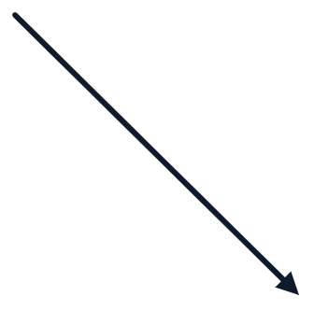
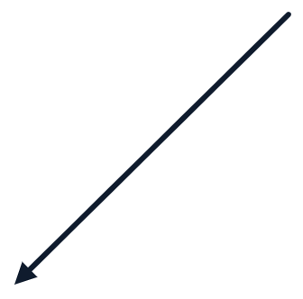
The recurrence
04 · DYNAMIC PROGRAMMING
Take item i
Skip item i
WHEN CAN WE TAKE?
v[i] + dp[i−1][c−w[i]]
dp[i−1][c]
w[i] ≤ c
If item i does not fit, only the skip option is left: dp[i][c] = dp[i−1][c].
dp[i][c] = max(take, skip)
Base case: dp[0][c] = 0, because with no items the value is 0.
Notes:
Every cell has just two options. Either we skip item i, and the value is whatever the previous row gave us with the same capacity. Or we take item i, which costs w[i] of the capacity but adds v[i] to the value, so we look up the previous row at capacity c minus w[i]. We keep the larger one. We can only take the item if it fits. With zero items, the value is zero.

Slide 11







Algorithm flowchart
04 · DYNAMIC PROGRAMMING
Start
Create dp table, fill row 0 with 0
for i = 1 to n
for c = 0 to W
each item
each capacity
Legend
skip = dp[i−1][c]
Yes
w[i] ≤ c ?
Rounded box: start and end
take = v[i] + dp[i−1][c−w[i]]
Rectangle: a step
dp[i][c] = max(skip, take)
Diamond: a yes/no decision
No
Answer: dp[n][W]
Cell done: next c, then next i
dp[i][c] = dp[i−1][c]
item does not fit
repeat until every cell is filled
Notes:
This flowchart is the whole algorithm. We create the table and set the first row to zero. Two loops visit every item i and every capacity c. At each cell we ask one question: does item i fit, that is, is its weight at most c? If yes, we compute both options, skip and take, and keep the larger. If no, we copy the cell above. When all cells are done, the answer sits in the bottom-right cell, dp of n and W.

Slide 12
The filled DP table
04 · DYNAMIC PROGRAMMING
items
c=0
c=1
c=2
c=3
c=4
c=5
c=6
c=7
How to read it
none
0
0
0
0
0
0
0
0
Each cell is the best value for the listed items at that capacity.
“A–C” means items A, B and C are available.
Values never shrink as capacity grows.
The bottom-right cell is the answer: 9 pts.
A
0
1
1
1
1
1
1
1
A–B
0
1
1
4
5
5
5
5
A–C
0
1
1
4
5
6
6
9
A–D
0
1
1
4
5
7
8
9
Notes:
This is the table after the algorithm has run on our example. Rows are the items we are allowed to use, columns are the bag capacity from 0 to 7. Read any cell as: the best value you can get with these items and this capacity. Notice values only grow to the right and downward. The highlighted bottom-right cell holds the final answer, 9 points.

Slide 13
One cell, step by step
04 · DYNAMIC PROGRAMMING
dp[3][7]
dp[4][7]
Item C (4 kg, 5 pts), capacity 7
Item D (5 kg, 7 pts), capacity 7
Skip
dp[2][7] = 5
Skip
dp[3][7] = 9
Take
5 + dp[2][3] = 5 + 4 = 9
Take
7 + dp[3][2] = 7 + 1 = 8
max(5, 9) = 9, so take C
max(9, 8) = 9, so skip D
Every cell needs only two lookups in the row above, so filling the table is fast.
Notes:
Let us compute two cells by hand. For dp of 3 and 7 we consider the stove, 4 kg and 5 points. Skipping gives the value from the row above, 5. Taking it leaves 3 kg of capacity, and the row above at capacity 3 is 4, so the total is 5 plus 4, which is 9. We keep 9. For dp of 4 and 7 the camera would give only 8, so skipping it, with 9, wins.

Slide 14
Tracing back the answer
04 · DYNAMIC PROGRAMMING
items
c=0
c=1
c=2
c=3
c=4
c=5
c=6
c=7
1
dp[4][7] = 9 equals dp[3][7], so skip D.
none
0
0
0
0
0
0
0
0
A
0
1
1
1
1
1
1
1
2
dp[3][7] = 9 differs from dp[2][7] = 5, so take C. Capacity left: 7 − 4 = 3.
A–B
0
1
1
4
5
5
5
5
A–C
0
1
1
4
5
6
6
9
3
dp[2][3] = 4 differs from dp[1][3] = 1, so take B. Capacity left: 3 − 3 = 0, stop.
A–D
0
1
1
4
5
7
8
9
Chosen items: B and C · total weight 7 kg · total value 9 pts
Notes:
The table gives the best value, but which items make it? We walk backwards from the bottom-right cell. If a cell equals the one directly above it, that item was skipped. If it differs, the item was taken, and we move up and left by the item’s weight. Here we skip the camera, take the stove, take the tent, and the capacity reaches zero. So the answer is tent plus stove: 7 kg, 9 points.

Slide 15
Python implementation
04 · DYNAMIC PROGRAMMING
def knapsack(w, v, W):
n = len(w)
dp = [[0] * (W + 1) for _ in range(n + 1)]
for i in range(1, n + 1):
for c in range(W + 1):
dp[i][c] = dp[i-1][c] # skip item i
if w[i-1] <= c: # item i fits
dp[i][c] = max(dp[i][c], v[i-1] + dp[i-1][c-w[i-1]])
return dp[n][W]
Example
knapsack([1, 3, 4, 5], [1, 4, 5, 7], 7) returns 9
Notes:
This is the flowchart as code. The table dp has n plus 1 rows and W plus 1 columns. Two loops visit every cell. First we copy the value from the row above, which is the skip option. Then, if the item fits, we compare with the take option and keep the maximum. Running it on our example returns 9.

Slide 16
Time and space
05 · ANALYSIS
Approach | Time | Space | Always optimal
Brute force | O(2^n) | O(n) | Yes
Greedy by value per kg | O(n log n) | O(1) | No
DP with full table | O(nW) | O(nW) | Yes
DP with one row | O(nW) | O(W) | Yes
Pseudo-polynomial
The one-row trick
Time grows with the size of the number W, not only with how many digits W has.
Row i needs only row i−1, so keep one array and loop c from W down to 0.
Notes:
Here is how the approaches compare. Brute force is exponential. Greedy is very fast but not always right for 0/1 items. Dynamic programming takes n times W steps, which is far smaller than 2 to the n for realistic sizes. It is called pseudo-polynomial because W is a number, so the running time depends on its value. Since each row only needs the previous row, we can cut the memory to a single array of size W plus one.

Slide 17
Where it is used
05 · ANALYSIS
Budgeting
Cargo loading
Investing
Choose the projects that give the most return within a fixed budget.
Fill a truck or container with the most valuable load under a weight limit.
Pick the assets with the best expected return for a limited amount of capital.
Cloud computing
Cutting stock
Time planning
Place jobs on a server with limited CPU and memory.
Cut raw material so the pieces you keep are worth the most.
Choose the tasks that earn the most marks in the hours available.
Notes:
Knapsack appears whenever you have a limited resource and many options. The resource can be money, weight, memory or time. The same recurrence solves all of them, only the meaning of weight, value and capacity changes.

Slide 18


Key takeaways
06 · WRAP-UP
1
Knapsack asks for the most value within a capacity limit.
2
Brute force checks all 2^n subsets, which is far too slow.
Questions?
3
Greedy by value per kg is fast but can miss the best 0/1 answer.
Thank you for listening
4
DP fills a table with dp[i][c] = max(skip, take) in O(nW) time.
Notes:
To summarise: knapsack is about choosing items under a capacity limit. Brute force is correct but exponential. Greedy is fast but not always right for 0/1 items. Dynamic programming stores the answers to smaller subproblems and solves the problem in n times W steps. Thank you, I am happy to take questions.

